Slide 1

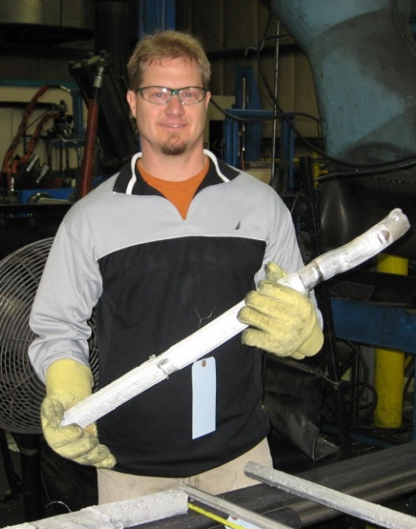


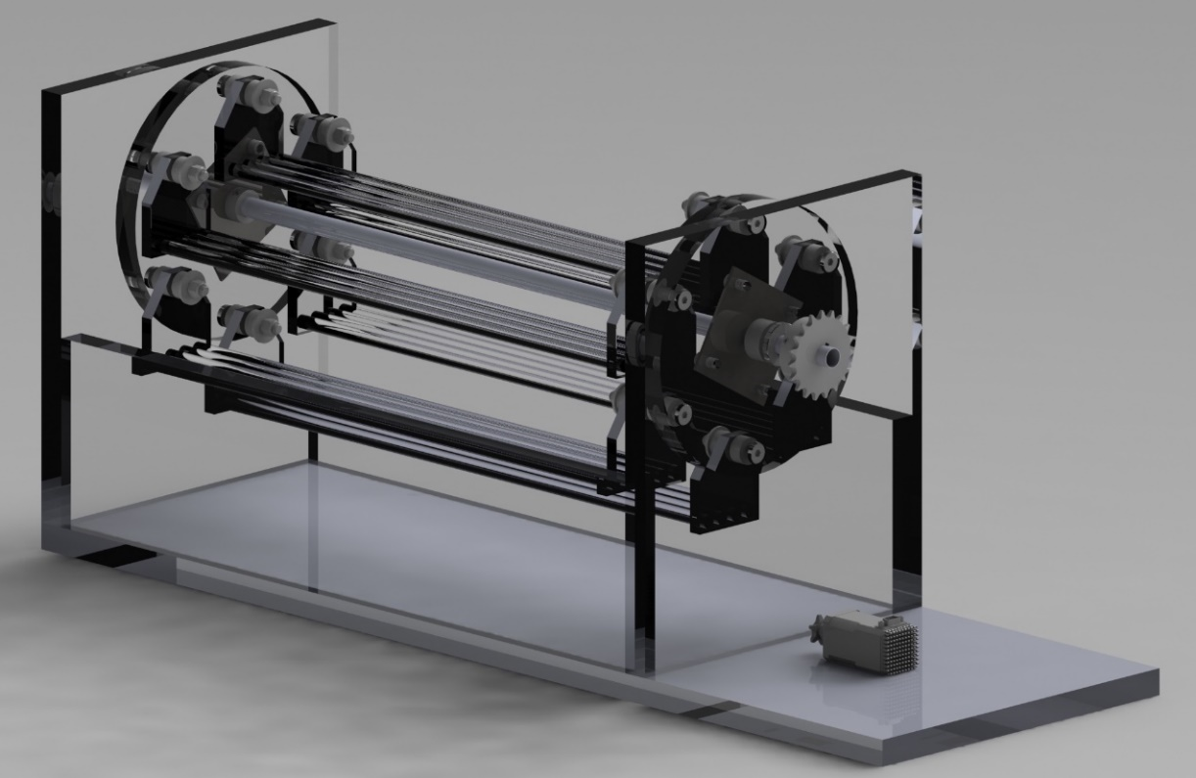
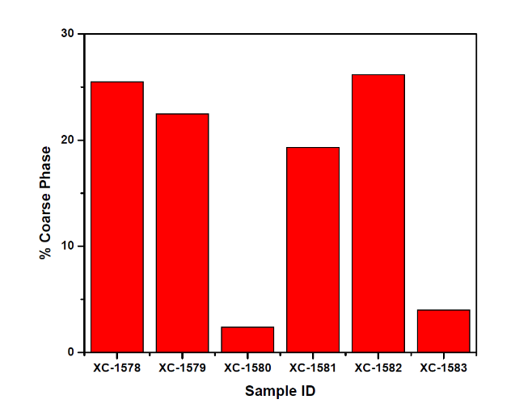
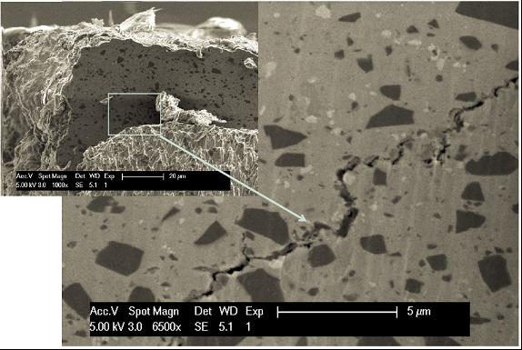
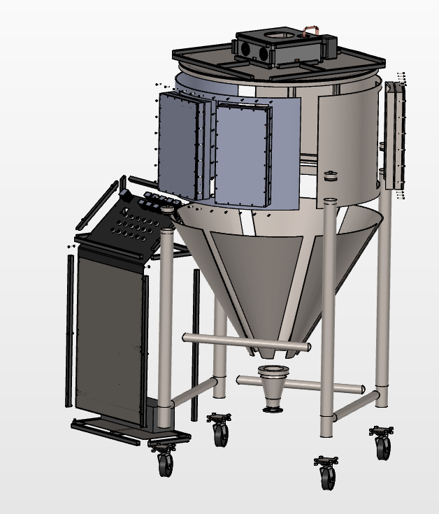
The Title of Your Thesis Should be Here…Adjust Font and Size of Box as Needed…It could be smaller
Student Name^{1,2}, Advisor 1 name, Ph.D (or other suffix/prefix)¹, Advisor 2 name, Ph.D (or other suffix/prefix)¹
Department of Mechanical Engineering, California State University, Sacramento
Other affiliation, if any (company, university, etc.)
Pick a logo you like. If you have collaborators or sponsorship, add theirs.
Maybe a picture here
PROBLEM STATEMENT
Your abstract should be about 200 words, this is about 200 words. Duis finibus condimentum odio id varius. In vulputate felis ut laoreet gravida. Sed laoreet ex vitae venenatis gravida. Donec pulvinar consectetur augue, quis dapibus nulla efficitur et. In id blandit tortor. Suspendisse vel tellus odio. Nulla sit amet augue in magna varius lobortis. Maecenas eget elit mollis, consequat enim sit amet, maximus tortor. Nunc cursus, arcu porta rhoncus vehicula, nulla nulla lobortis ex, ut efficitur ex mauris imperdiet purus. Ut tristique, felis a ullamcorper bibendum, augue nunc condimentum neque, vel vehicula nisl arcu quis libero. Phasellus et bibendum est, vel interdum metus. Nulla est leo, interdum eu accumsan id, auctor sit amet lacus. Etiam non leo tempor, posuere ante ac, dapibus metus. Donec sodales tristique laoreet. Proin in felis nec orci commodo venenatis quis a lorem. Morbi varius feugiat tellus. Proin mollis, lectus ut fringilla molestie, purus neque feugiat eros, eu ultricies mi purus eget augue. Suspendisse accumsan nulla non ligula semper, condimentum pharetra mauris pharetra. Donec blandit orci id ipsum porta fringilla. Aliquam feugiat nulla vel nulla fringilla mollis. Pellentesque habitant morbi tristique senectus et netus et malesuada fames ac turpis egestas. Aenean at scelerisque turpis. Vivamus non efficitur erat. Vivamus.
BACKGROUND
SUMMARY OF WORK
IMPACT ON COMMUNITY
Powder metallurgy is one technique for development of ultra-high performance (UHP) alloys and metal matrix composites. But, processing these materials can be expensive and, in some cases, hazardous. In ongoing efforts with partners in academia and in industry, we investigate cryomilling of alloy powders (Fig. 1) to generate powders that can be consolidated into UHP alloys. Cryomilling is an expensive process that enhances
Stress Corrosion Cracking Ferris Wheel
Programmable Logic Control (PLC) for automated alternate immersion testing
Can be performed in tension or other orientations
Used as research or teaching instrument
The intended, long-term impact of this work includes:
Improved scalability of ultra-high performance alloys and metal matrix composites.
Enhanced characterization of developed alloys to improve opportunities for commercial deployment.
Contributions possible in the arena of additive manufacturing.
Students trained in these research arenas will have a hands-on skill set that can be applied in aerospace, automotive, defense and energy applications.
Techniques and tools of characterization are not limited to powder-based UHP metal matrix composites – leading to broader impacts.
Figure 3: (above) Model of alternate immersion testing device for stress corrosion cracking (SCC) testing.
Figure 4: (left) SEM micrograph showing crack propagation through UHP metal matrix composite.
Figure 1: (above and left) CSUS Student, Gaunt Murdock, cryomills UHP alloys at a collaborating facility. Figure 2: (Left) Centrifugal atomizer developed by CSUS student, Chris Potts, for powder production
Notes:
Enable guides to view printable area. Half inch bleeds (vertical guidelines which denote extra print area for when the physical posters are made) are included on either side of the document. Make sure your content is not overlapping or extending past these guides, as any content outside this area will be cut when the physical poster is made.

